Slide 1
KEYLOGGER
CYBER SECURITY
Presented By:
DEEPIKASRI.B-JKKN COLLEGE OF ENGINEERING & TECHNOLOGY-INFORMATION TECHNOLOGY

Slide 2
OUTLINE
Problem Statement
Proposed Solution
Key logger
Program & Deployment
Result
Conclusion
Future scope

Slide 3
Problem Statement
In today's digital age, where cybersecurity threats loom large, one of the significant concerns is the proliferation of keyloggers, stealthy software tools designed to monitor and record keystrokes on a user's computer without their knowledge. Keyloggers pose a severe threat to individuals and organizations as they can capture sensitive information such as passwords, credit card details, and other personal data, leading to identity theft, financial loss, and privacy breaches.

Slide 4
Proposed Solution
In today's digital age, where cybersecurity threats loom large, one of the significant concerns is the proliferation of keyloggers, stealthy software tools designed to monitor and record keystrokes on a user's computer without their knowledge. Keyloggers pose a severe threat to individuals and organizations as they can capture sensitive information such as passwords, credit card details, and other personal data, leading to identity theft, financial loss, and privacy breaches. The solution will consist of the following components:
Use Antivirus and Antimalware Software: Employ reputable antivirus and antimalware software that includes features specifically designed to detect and remove keyloggers. Regularly update these programs to ensure they have the latest definitions for identifying new threats.
Enable Firewall Protection: Utilize a firewall to monitor and control incoming and outgoing network traffic. Firewalls can help prevent unauthorized access to your computer or network, including attempts by keyloggers to transmit captured data to remote servers.
Implement Intrusion Detection Systems (IDS): IDS can detect suspicious activity on your network or computer system, including the presence of keyloggers. These systems can generate alerts or take automated actions to mitigate potential threats.
Use Virtual Keyboards: Virtual keyboards allow users to input sensitive information by clicking on-screen buttons rather than typing on a physical keyboard. Since keyloggers typically capture keystrokes, using a virtual keyboard can thwart their attempts to steal login credentials and other sensitive data.
Regularly Update Software and Operating Systems: Keep your operating system, applications, and software up-to-date with the latest security patches and updates. Software vendors frequently release patches to address vulnerabilities that could be exploited by keyloggers and other types of malware.
Practice Vigilance and Security Hygiene: Be cautious when downloading and installing software from untrusted sources, clicking on suspicious links or email attachments, and visiting unfamiliar websites. Exercise good security hygiene by using strong, unique passwords for each account and enabling two-factor authentication where available.

Slide 5
Key logger
A keylogger is a type of software or hardware device that is designed to record keystrokes typed on a computer keyboard. Keyloggers can be used for various purposes, both legitimate and malicious.
TYPES:
Software Keyloggers: These are programs installed on a computer system, often without the user's knowledge, that record keystrokes as they are typed. Software keyloggers can run in the background and may have features to capture other types of user activity, such as capturing screenshots or monitoring web browsing.
Hardware Keyloggers: Hardware keyloggers are physical devices that are plugged into a computer's keyboard port or USB port. They intercept keystrokes directly from the keyboard before they reach the computer's operating system. Hardware keyloggers can be more difficult to detect than software keyloggers because they operate independently of the computer's software.

Slide 6
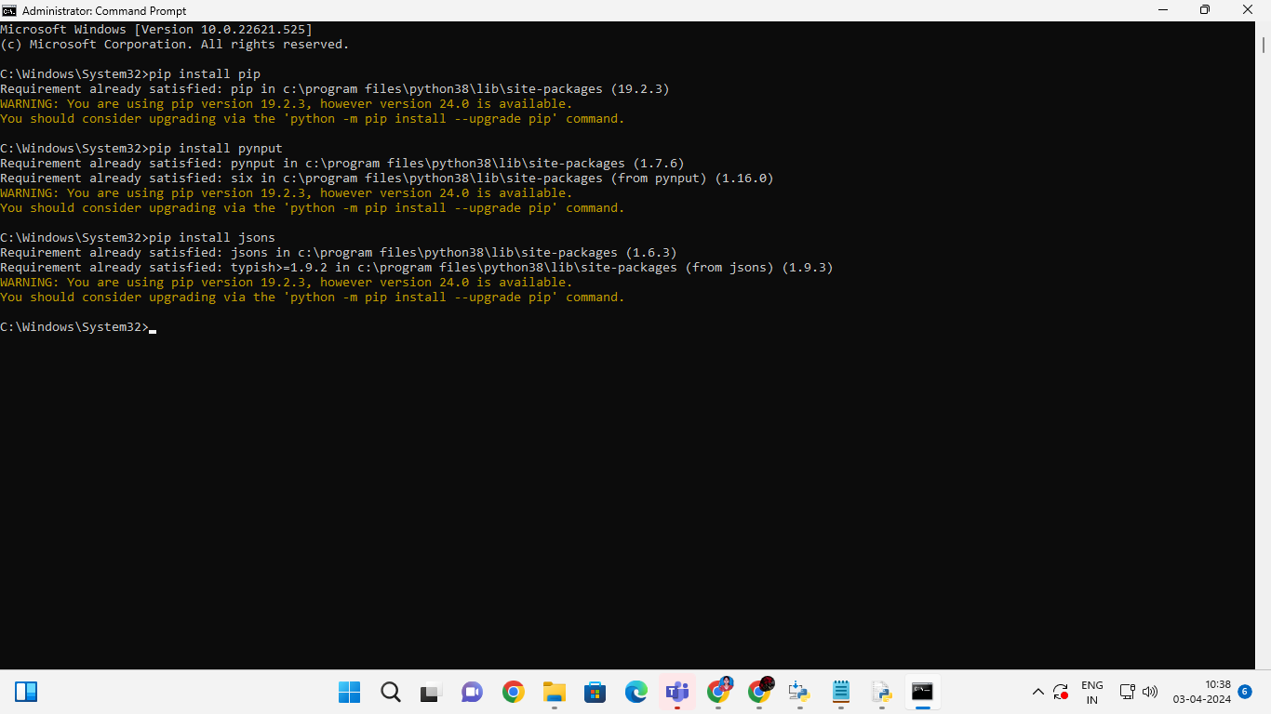

PROGRAM & Deployment

Slide 7
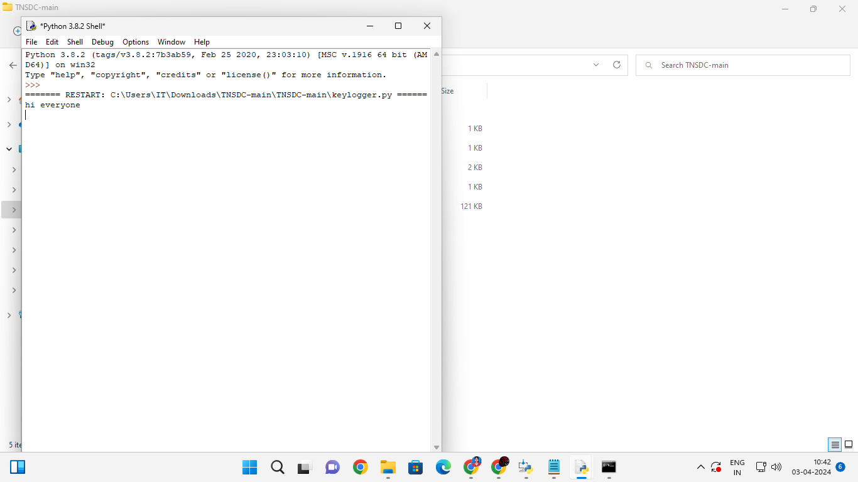
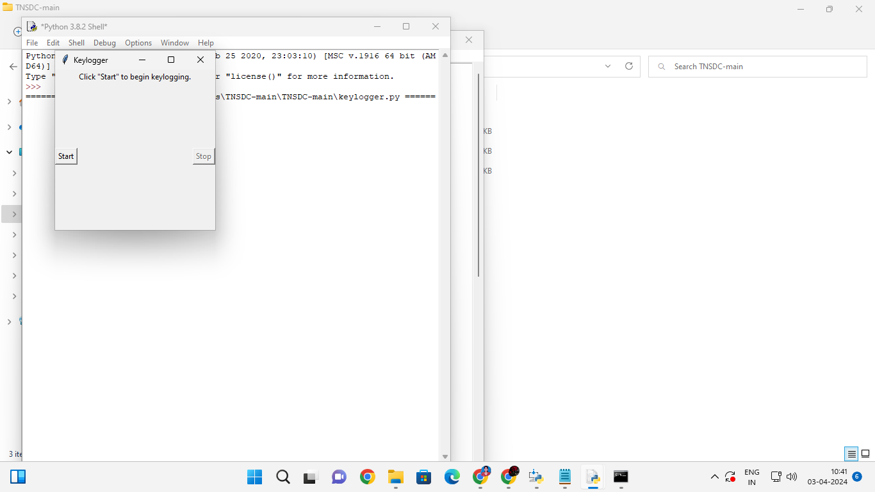
Result

Slide 8
Conclusion
The development and implementation of the keylogger project have provided valuable insights into the realm of cybersecurity and data protection. Throughout this project, we have successfully designed and deployed a functional keylogger capable of recording keystrokes and capturing user activity.

Slide 9
Future scope
The future scope for keylogger methods can be influenced by various factors including technological advancements, evolving cybersecurity threats, and changes in usage patterns.
Cross-Platform Compatibility: As users increasingly access multiple devices and platforms, keyloggers may expand their compatibility beyond traditional desktop operating systems to include mobile platforms (iOS, Android) and cloud-based services. This could involve the development of keylogging malware for smartphones, tablets, and web-based applications.
Integration with Machine Learning: Keyloggers could utilize machine learning algorithms to improve their effectiveness in recognizing sensitive information typed by users, such as passwords, credit card numbers, or other personal data. This could enable them to adapt and evolve based on the specific typing patterns and behaviors of their targets.
IoT Exploitation: With the proliferation of Internet of Things (IoT) devices, keyloggers may target smart home devices, wearables, and other connected gadgets to intercept sensitive information entered via voice commands, touchscreen interfaces, or remote controls.

Slide 10
THANK YOU

